Slide 1
Learning to Read and Spell
Chapter 8

Slide 2
Normal Reading Development
Alphabetic reading – when you are learning to sound words out (grapheme-phoneme correspondence).
Skilled reading involves using that direct route between words and lexicon.
So learning to read involves a shift away from sounding things out to lexical route use.

Slide 3
Normal Reading Development
Stages
Pre-alphabetic – we do not know the grapheme-phoneme correspondence
So we learn the connection between visual words and their meaning
Remembering the concept with visual pattern

Slide 4
Normal Reading Development
Stages
Partial alphabetic reading phase – start to form sound to spelling rules
Letters get associated with sounds

Slide 5
Normal Reading Development
Stages
Full alphabetic stage – full GPC mapping available
Now we can sound things out
Start to map through the lexical route

Slide 6
Normal Reading Development
Stages
Consolidated alphabetic stage – reading like an adult
Rimes are familiar, can use syllables, morphemes

Slide 7
Normal Reading Development
Poor readers – can’t get past the second stage because of poor phonological recoding
Competent readers – know both the alphabetic system of spelling and specific word spelling
Know exception spellings and sounds

Slide 8
Normal Reading Development
Phonological awareness
Awareness of sounds, measured by tasks such as naming the common sounds in words, and deleting a sound from a word
Important in reading development
Important in other language development

Slide 9
Normal Reading Development
Phonological awareness
Epilinguistic knowledge – implicit knowledge about our language processes
Metalinguistic knowledge – explicit knowledge about our language processes

Slide 10
Normal Reading Development
Phonological awareness
Tests tend to measure:
Manipulating single sounds
Holding sounds in memory
Segmenting skills
Rhyming skills

Slide 11
Normal Reading Development
Phonological Awareness Development
Implicit awareness – measured by matching sounds, detecting oddities
Little effect on learning to read
Explicit awareness – measures by isolating, segmenting, and manipulating sounds
Learning to read through GPC
Notes:
Rime awareness, segmentation, letter name knowledge strong predictors of learning to read
Training phonological awareness helps reading

Slide 12
Normal Reading Development
Early Reading Units
Analogy – it’s hard for people to sound things out and blend phonemes together…so they read by analogy
Given clue word (beak)
Ask to read related words (bean, beal, peak)

Slide 13
Normal Reading Development
Early Reading Units – Analogy Learning
You have to learn the sound to spelling rules first, before you can break things down to learn by analogy
Younger readers prefer GPC, older readers prefer analogy

Slide 14
Normal Reading Development
Early Reading Units – Analogy Learning
Some languages (like German) are more regular with their GPC, so they use analogy less
Psycholinguistic grain size – different languages use different preferred reading unit size

Slide 15
Normal Reading Development
Teaching Reading
Age does not seem to matter
Older readers learn faster
Teaching at a young age doesn’t seem to help
Approaches
Look and say or whole word method – learn to associate sound with visual input or pattern
Phonic method – taught to associate sounds with letters and sound things out

Slide 16
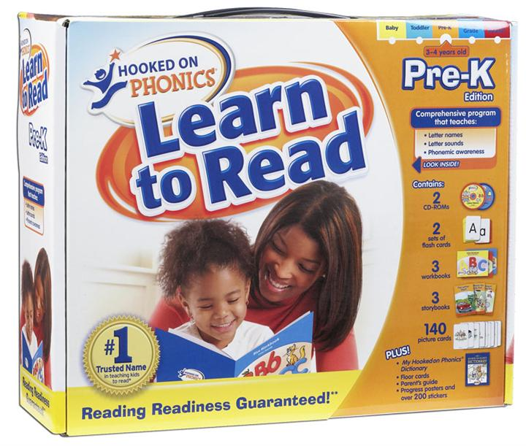
Normal Reading Development
Teaching Reading

Slide 17
Normal Reading Development
Teaching Reading
Phonic method seems to be best
Word only method seems make you bad at pronouncing new words
Sounds like phonological dyslexia

Slide 18
Normal Reading Development
Teaching Reading – Ways to Teach Phonics
Analytic phonics – taught after reading has started
Letter sounds are introduced gradually
Reading practices with sets of words that share sound (dig dog)

Slide 19
Normal Reading Development
Teaching Reading – Ways to Teach Phonics
Synthetic phonics – taught all the letters and sounds before anything else
Teach word building activities on how to put words together
Seems to work best and give advantages to children later.

Slide 20
Normal Reading Development
Teaching Reading – Ways to Teach Phonics
Exposure to print – games that manipulate letters, words also very highly beneficial

Slide 21
Normal Reading Development
Learning to Spell
Learning to spell models are a reverse of the reading models
Same spelling problems as with reading
At very young ages when children learn to spell they think that words should be based on their meanings (don’t understand alphabet)
Whale should be a long word because it’s a big thing, versus mosquito should be a small word

Slide 22
Normal Reading Development
Learning to Spell
Early spelling errors reflect over-generalization of alphabetic rules – eat > et because it has two sounds
Problems with vowels because they make different sounds – happy > hape, like > lik

Slide 23
Normal Reading Development
Learning to Spell
Reduce large consonant clusters down to one letter – street > set, be > b, should > c
Sensitive to cluster placement – ck occurs a lot but never at the beginning, so they rarely spell things with a ck at the beginning

Slide 24
Developmental Dyslexia
Definition: impairment in developing reading abilities, not due to brain damage, reading abilities are impaired.
Dysgraphia – problems with writing and spelling
Often co-occur together
10-30 percent of the population
Reading age is below what is expected of your IQ and age

Slide 25
Developmental Dyslexia
Biology of Dyslexia
Things associated with dyslexia, but we’re not clear why:
Left handedness
Clumsier – maybe?
Sometimes visual short term memory impairment

Slide 26
Developmental Dyslexia
Biology of Dyslexia
Magnocelluar visual pathway – large cells that respond to contrast and movement, seems to cause people thinking the letters are moving and dancing around the page.

Slide 27
Developmental Dyslexia
Biology of Dyslexia
Planum temporale – structure in Wernicke’s area, usually larger in the left in normal people, about the same for dyslexics
Tends to cause problems with phonology
Larger / more neurons in the occipital areas as people are using visual information to cope with the problems.

Slide 28
Developmental Dyslexia
Surface developmental dyslexia – they make the same errors that people do at that reading level sounding out nonwords
Less training, less reading, visual perceptual deficits, problems connecting orthography to phonology

Slide 29
Developmental Dyslexia
Phonological dyslexia occurs from damage to phonological representations before you learn to read

Slide 30
Developmental Dyslexia
What can we do to help?
Teach phonological awareness, especially at a young age (games!)
Teaching people to segment words into onsets and rimes

Slide 31
Developmental Dyslexia
What can we do to help?
Orton-Gillingham-Stillman multisensory methods
Systematic and explicit teaching of GPC rules
Children see say write and feel new spelling patterns
Seems to work well

